Slide 1
COMP1003 – Algorithms, Data Structures & Maths Session 07 Logic
Thomas Wennekers
University of Plymouth

Slide 2
Overview
Sets and Logic
Data Base Queries
Intelligent Systems
Tautologies

Slide 3
Sets Reminder
Ø … the empty set
When the elements are listed or defined, sets are written in curly brackets
{2, 4, 7}
{Alan, John, Fred}
If A and B are sets then
|A| is the size of A
A ∩ B = {x : x ∈ A and x ∈ B} (intersection)
A ∪ B = {x : x ∈ A or x ∈ B} (union)
A / B = {x : x ∈ A and x ∉ B} (difference)
These sets are finite
Some pretty fundamental operators used in database queries

Slide 4
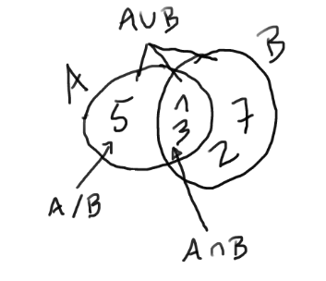
Sets
If A = {1,3,5} and B = {1,2,3,7} then
|A| = 3
|B| = 4
A ∩ B = {1, 3}
A ∪ B = {1,2,3,5,7}
A / B = {5}

Slide 5
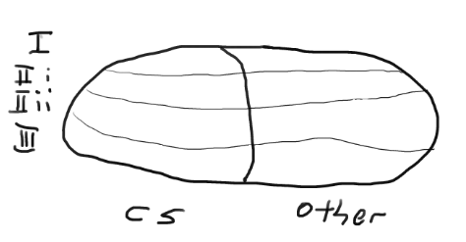
Database queries
For each degree classification (I, IIi, IIii, III), retrieve the number of Computer Science students who graduated this year with that degree classification: counting

Slide 6
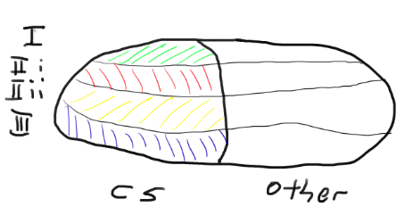
Database queries
For each degree classification (I, IIi, IIii, III), retrieve the number of Computer Science students who graduated this year with that degree classification: counting

Slide 7
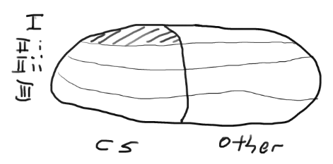
Database queries
For each degree classification (I, IIi, IIii, III), retrieve the number of Computer Science students who graduated this year with that degree classification: counting
List those students who are studying Computer Science who have gained a first class degree: intersection

Slide 8
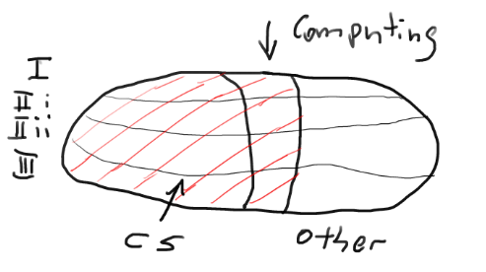
Database queries
For each degree classification (I, IIi, IIii, III), retrieve the number of Computer Science students who graduated this year with that degree classification: counting
List those students who are studying Computer Science who have gained a first class degree: intersection
List those students studying Computer Science, Computing or Web Applications: union

Slide 9
Database queries
For each degree classification (I, IIi, IIii, III), retrieve the number of Computer Science students who graduated this year with that degree classification: counting
List those students who are studying Computer Science who have gained a first class degree: intersection
List those students studying Computer Science, Computing or Web Applications: union
List those Computer Science students who have not already submitted their registration forms: difference

Slide 10
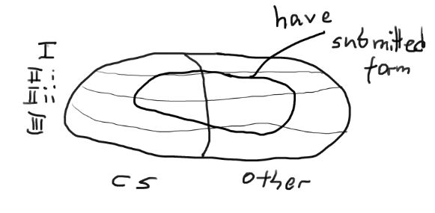
Database queries
List those Computer Science students who have not already submitted their registration forms: difference

Slide 11
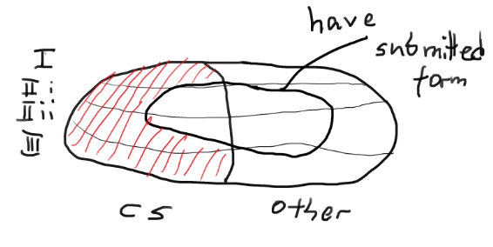
Database queries
List those Computer Science students who have not already submitted their registration forms: difference

Slide 12
Sets and Logic
Statements characterise sets in a data base
Compound statements characterise sub-sets
Set operations correspond with compound statements
Sets underlie Logical reasoning about data

Slide 13
Sets and Logic
Subsets are often called “events”
.. especially in probability theory (think dice)
.. sets also underlie probability theory
-> next session

Slide 14
Sets and Logic
Statements characterise sets in a data base
consider the world a data base ..
.. same principles apply as for DBs

Slide 15
Sets and Logic
Statements characterise sets in a data base
consider the world a data base ..
.. same principles apply as for DBs
but not always (obviously)

Slide 16
Crisp vs fuzzy sets
When the membership of a set is black or white, we say that we have a crisp set
All the sets presented before are crisp
Crisp sets suggest “2-valued logic” – something is in the set or it isn’t – and there are no in-betweens
2-valued logic seems to fit very well with computer-based systems which operate using binary logic
A fuzzy set is one that is not crisp, e.g.,
{x ∈ R : x is very small}

Slide 17
2. Intelligent systems
An intelligent system will need to be able to reason about its domain
This might be achieved by providing the system with information about the application domain:
General knowledge (which is typically fairly stable), and
Current facts/data (which may be fairly changeable)
… and of course methods for manipulating this information

Slide 18
Knowledge vs. facts/data
Example
You possess knowledge about the geography of the University campus … this knowledge grows (as you learn) but is subsequently fairly stable
To get to the Babbage building you derive a route from:
the above knowledge, and
one current piece of data: your present location

Slide 19
Knowledge vs. facts/data
Example
A medical expert system would contain general medical knowledge
Specifically how symptoms/illnesses are interrelated
A diagnosis would be based upon this general medical knowledge together with the “current” data
Your symptoms and medical history

Slide 20
3. Propositional logic
A language for representing and method for reasoning with information is called a logic
The simplest 2-valued logic is propositional logic
A proposition (a.k.a. a Boolean variable) is a variable that takes the values TRUE or FALSE
Given propositions p, q, r, s, … we can build up complex formulae which in turn will have a truth value depending upon the truth values of the raw elements p, q, r, s, …

Slide 21
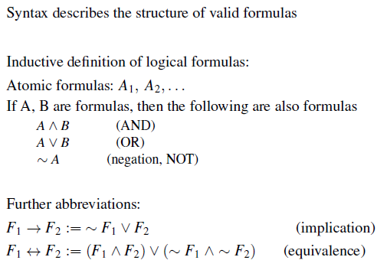
Propositional “Boolean” Syntax is recursively defined

Slide 22
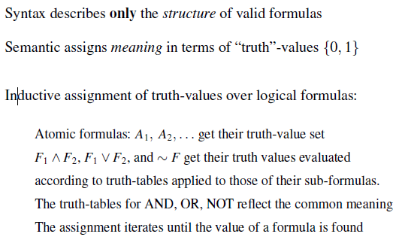
Sematic is also recursively defined (in tandem with the syntactic construction)

Slide 23
Propositional truth tables
θ | ϕ | θ∧ϕ
T | T | T
T | F | F
F | T | F
F | F | F
and
θ | ϕ | θ∨ϕ
T | T | T
T | F | T
F | T | T
F | F | F
or
θ | ϕ | θ→ϕ
T | T | T
T | F | F
F | T | T
F | F | T
θ | ϕ | θ↔ϕ
T | T | T
T | F | F
F | T | F
F | F | T
θ | ¬θ
T | F
F | T
not
implies
if and only if (iff)
¬ takes precedence over the other operators; ∧ and ∨ have precedence over ↔ and →

Slide 24
Precedence
¬p∧q means (¬p)∧q
If you wanted to take the “and” first, then use brackets: ¬(p∧q)
p∧q∨r is meaningless because the 2 operators have the same precedence: you need brackets
p∧q→r means (p∧q)→r … again if you wanted to do the implication before the “and” then you need brackets: p∧(q→r)

Slide 25
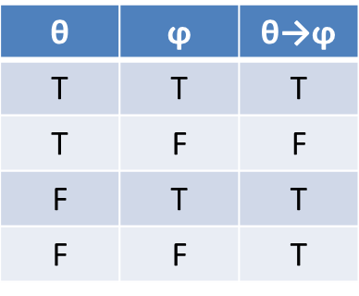
Implies
Note that θ→ϕ is false iff θ is true and ϕ is false
The case when θ is false cannot invalidate the implication

Slide 26
θ↔ϕ is logically equivalent to (θ→ϕ) ∧ (ϕ→θ)
θ | ϕ | θ→ϕ | ϕ→θ | (θ→ϕ) ∧ (ϕ→θ) | θ↔ϕ
T | T | T | T | T | T
T | F | F | T | F | F
F | T | T | F | F | F
F | F | T | T | T | T
So (θ→ϕ) ∧ (ϕ→θ) and θ↔ϕ are logically equivalent: when one is true, so is the other

Slide 27
Some propositional formulae
Consider the formula
θ: (p ∧ q) ∨ ¬q
Then θ is true if and only if (iff)
p and q are both true, or
¬q is true, i.e., q is false
… and – with a little thought – you may note that this is the case iff p∨¬q is true

Slide 28
Logical equivalence
To demonstrate logical equivalence, we can generate the truth table
p | q | ¬q | p ∧ q | (p ∧ q) ∨ ¬q | p ∨ ¬q
T | T | F | T | T | T
T | F | T | F | T | T
F | T | F | F | F | F
F | F | T | F | T | T
So (p ∧ q) ∨ ¬q and p ∨ ¬q are logically equivalent: when one is true, so is the other

Slide 29
… or we can show that each formula implies the other
Suppose (p ∧ q) ∨ ¬q is true, then either
(p ∧ q) is true, in which case p is true and therefore p∨¬q is true, or
¬q is true, hence p∨¬q is true
Suppose that p∨¬q is true, then either
¬q is true, hence (p ∧ q) ∨ ¬q is true, or
¬q is false, hence p is true and therefore so are (p ∧ q) and (p ∧ q) ∨ ¬q

Slide 30
Some propositional formulae
Consider the formula
θ: (p ∧ q) → ¬q
Then θ is false iff the LHS is true and the RHS is false iff
p and q are both true, and
¬q is false (i.e., q is true)

Slide 31
Logical equivalence
p | q | p ∧ q | ¬q | (p ∧ q) → ¬q
T | T | T | F | F
T | F | F | T | T
F | T | F | F | T
F | F | F | T | T
So (p ∧ q) → ¬q is false iff p ∧ q is true

Slide 32
4. Tautologies
… in propositional logic
Consider the formula θ: (p ∧ q) → p
Then θ is false iff the LHS is true and the RHS is false iff
p and q are both true, and
p is false
which of course can never happen.
θ is always true regardless of the assignment of truth values (to its component propositions) and is said to be tautologous or universally valid

Slide 33
Logical consequence
If θ and ϕ are formulae, then ϕ is a logical consequence of θ iff for any assignment of truth values, if θ is true then so is ϕ
i.e., θ → ϕ is tautologous
Determining whether one statement follows from a set of others is undoubtedly the most common reasoning problem in automated systems

Slide 34
Logical consequence
θ → ϕ is tautologous iff there is no assignment of truth values which makes θ → ϕ false
i.e., which makes θ true and ϕ false
Or put another way: if an assignment of truth values makes ϕ false, then it must also make θ false

Slide 35
(¬p → p) → p
Suppose that LHS is true and RHS = p is false
If p is false, then ¬p is true but then LHS = ¬p → p is false
We cannot simultaneously have the LHS being true and the RHS being false.
The formula is therefore tautologous
Some formulae have no obvious real-world meaning

Slide 36
Logical equivalence
Two formulae θ and ϕ are logically equivalent iff for any assignment of truth values:
if θ is true then so is ϕ, and
if ϕ is true then so is θ
iff θ ↔ ϕ is a tautology
i.e., θ ↔ ϕ is true

Slide 37
Some well known tautologies
p → p
(p ∧ q) → p
p → p ∨ q
p ∧ (p → q) → q [modus ponens]
(p ∧ q) ↔ (q ∧ p) [commutativity]
(p ∧ q) ∧ r ↔ p ∧ (q ∧ r) [associativity]
[(p → q) ∧ (q → r)] → (p → r) [transitivity]
p ∧ (q ∨ r) ↔ (p ∧ q) ∨ (p ∧ r) [distributivity]
p ∨ (q ∧ r) ↔ (p ∨ q) ∧ (p ∨ r) [distributivity]

Slide 38
p ∧ (q ∨ r) ↔ (p ∧ q) ∨ (p ∧ r)
If the LHS is true, then p is true and either q or r is true
If q is true, then so is p ∧ q, hence so is the RHS
If r is true, … ditto
If the RHS is true, then either p ∧ q or p ∧ r is true
If p ∧ q is true, then p is true and q is true – hence p ∧ (q ∨ r) is true
If p ∧ r is true, … ditto

Slide 39
Some well known tautologies
¬(p ∧ q) ↔ (¬p ∨ ¬q) [de Morgan’s laws]
¬(p ∨ q) ↔ (¬p ∧¬q) [de Morgan’s laws]
(p ∨ q) ∧ ¬q → p [resolution]
(¬p → q) ∧ ¬q → p [proof by contradiction]
(p → q) ↔ (¬q → ¬p)

Slide 40
¬(p ∧ q) ↔ (¬p ∨ ¬q)
Suppose that ¬(p ∧ q) is true, then (p ∧ q) is false and therefore p or q must be false
If p is false, then ¬p is true, and hence so is (¬p ∨ ¬q)
If q is false, then ditto …
Suppose that ¬p ∨ ¬q is true, then either ¬p is true or ¬q is true
If ¬p is true, then p is false and hence p ∧ q is false, hence ¬(p ∧ q) is true
If ¬q is true, then ditto …

Slide 41
(p ∨ q) ∧ ¬q → p
Suppose that (p ∨ q) ∧ ¬q is true then
(p ∨ q) is true, and
¬q is true (hence q is false)
But then since p ∨ q is true we must have that p is true

Slide 42
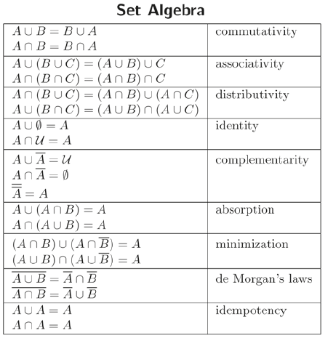
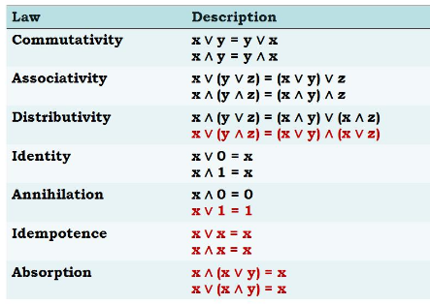
Set vs Boolean Algebra
Boolean Algebra

Slide 43
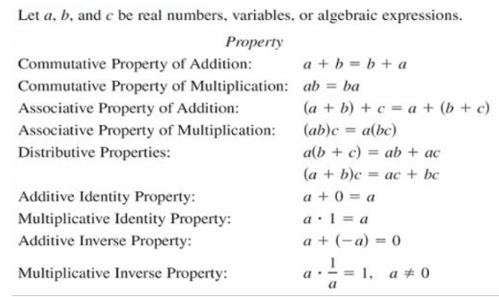
Arithmetic vs Boolean Algebra
Boolean Algebra
Similar enough such that we can use 0/1, + and * as logical values and operators

Slide 44

Predicate or First-order Logic
Inductively defined similar to Boolean logic
Adds predicates: Functions over elements of a domain
Adds: Quantifiers: For all and Exists
: “if it is not True that P(x) holds for all x it follows that there exists an x for which P(x) is False”
PL is at the base of Mathematics
Logical consequence in PL is semi-decidable

Slide 45
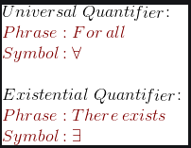
Predicate or First-order Logic
Inductively defined similar to Boolean logic
Adds predicates: Functions over elements of a domain
Adds: Quantifiers: For all and Exists
eg;
”if it is not True that P(x) holds for all x it follows that there exists an x for which P(x) is False”
PL is at the base of Mathematics
Prolog implements (part of) predicate logic
https://swish.swi-prolog.org/example/houses_puzzle.pl

Slide 46
5. Rule-based systems
A common form of “knowledge” is rules:
If X and Y and Z then R … in its simplest form, a propositional formula (X ∧ Y ∧ Z) → R
E.g., if (#defaults > 4) and (#defaults < 8) then increase mortgage rate by 1%
Rules can also have confidence values attached:
if symptom then illness (0.002%)
The elements of rules can also be uncertain:
if (temperature is high) and … then illness
fuzzy condition

Slide 47
Rule-based systems: deriving new information from knowledge & facts
Suppose that our knowledge base contains the rules
A ∧ E → B
A ∧ B ∧ D → C
D ∧ C → F
… and our current set of facts is A, E
By “firing” the first rule from left to right, we deduce that B is true, but we don’t know that D is true, and hence have no way of deducing that C or F are true
We might be tempted to “conclude” that D, C and F are false – since we have no way of proving them true

Slide 48
Rule-based systems: deriving new information from knowledge & facts
Suppose that our knowledge base contains the rules
A ∧ ¬F → B
A ∧ E → C
D ∧ C → F
… and our current set of facts is A, E
By firing the second rule we deduce that C is true, but we don’t know that D is true, and hence we also have no way of deducing that F is true.
Following on from the “logic” in the previous slide, we might therefore be tempted to “conclude” that D and F are false, and therefore (using the first rule) that B is true

Slide 49
Rule-based systems: deriving new information from knowledge & facts
Suppose that our knowledge base contains the rules
A ∧ ¬F → D
A ∧ E → C
D ∧ C → F
By firing the second rule we deduce that C is true, but we don’t know that D is true, and hence we also have no way of deducing that F is true. As before, we might be tempted to “conclude” that F is false
But then we can conclude that D is true (using the first rule) and that F is true (using the 3rd rule)!
Reasoning is clearly harder than it looks!
… and our current set of facts is A, E

Slide 50
6. Fuzzy logic and control systems
We think of computer systems as being based upon deterministic (i.e., non-random) rules
Suppose we had a computer system to drive a car: it would repeatedly
Take in information/readings/measurements from its sensors, then
Use these readings to compute values for output variables (gas, gear, brake, steering), and then
Apply these output values to the car via actuators

Slide 51
Fuzzy rules
Of course when we drive a car, we don’t do so by making these complex calculations
Instead we use heuristic rules (rules of thumb) such as:
If we are going too fast, we slow down a little by easing off the gas
If we are going way too fast, we slow down by disengaging the gas completely and applying the brake a little
If we are going to hit something we disengage the gas completely and apply the brake as hard as we can, or …
The statements in italics are unambiguous and binary/crisp, but those underlined are not – they are somewhat “fuzzy”

Slide 52
Fuzzy control systems
Moreover: when building a computerised control system (say to drive a car), it is more effective (and a whole lot simpler!) to mimic the human fuzzy approach rather than trying to derive complex formulae with which to compute the values for the output variables (gas, gear, brake, steering)
Obviously this requires us to be able to define fuzzy sets/variables in a precise way (so that the computer can handle them) … but it’s not that difficult

Slide 53
Crisp sets and membership
Suppose we are considering subsets of R (the real numbers)
A crisp subset A ⊆ R can be defined by a membership function
μ: R → {0,1}
For each x∈R, x∈A ↔ μ(x)=1
x ∈A ↔ μ(x)=0

Slide 54
Fuzzy sets
{x ∈ R : x is very small} could be defined by a membership function μ like this one
1
μ
-0.1
0
0.1
So x=0 is definitely in the fuzzy set (μ(x)=1)
If x ≥ 0.1 or x ≤ -0.1, then x is definitely not in the fuzzy set (μ(x)=0)
For -0.1 < x < 0.1, x is in the fuzzy set to a certain extent – which is given by its membership function μ
So for example, μ(0.05) = ½: 0.05 is half-in; half-out

Slide 55
Fuzzy rules
If (speed is very small) and (there is no traffic ahead) then (acceleration is high)
A value for speed translates into a membership value for “speed is very small” which (via the rule) yields a membership value for “acceleration is high” which in turn yields a value for acceleration
When there are multiple fuzzy statements on the LHS of the rule and multiple rules, the process becomes a little more complicated
1
1
0
10 km/hr
0
12
(km/hr)/s
Speed: Very small
Acceleration: High

